Slide 1
Maize Image Analysis using RGB and Multispectral Sensors
Saqib Ali
Precision Agriculture Lab
CAS-UAF

Slide 2
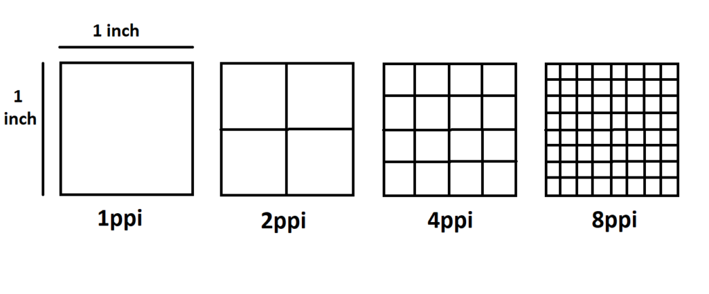
What is a Pixel?

Slide 3
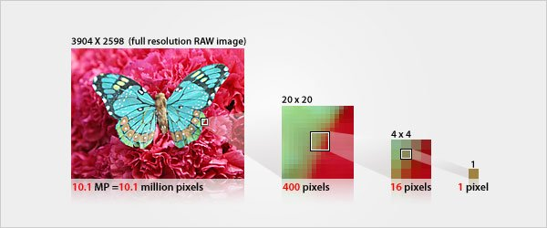
Image Resolution

Slide 4
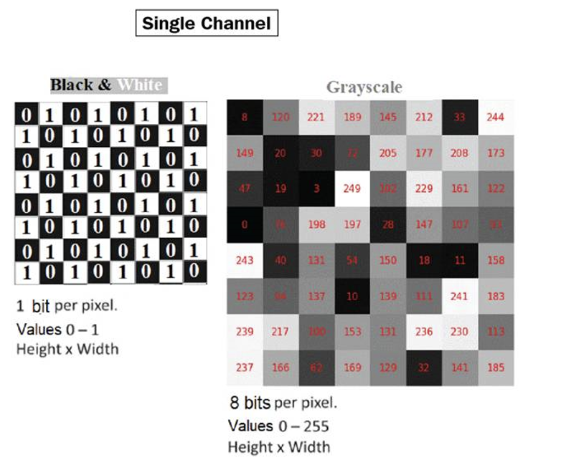
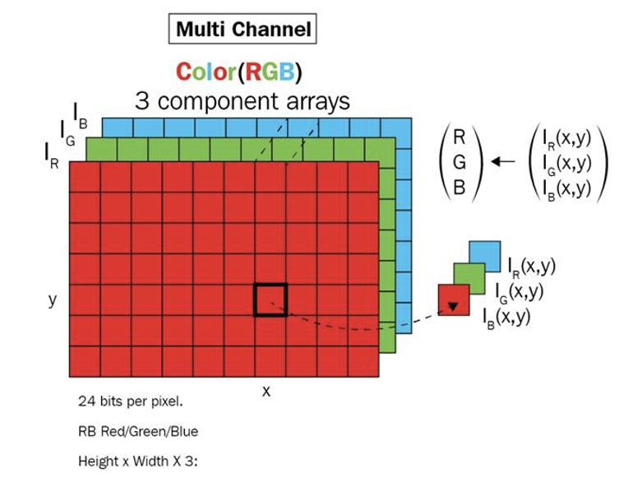
Image as Multidimensional Arrays and Matrices

Slide 5
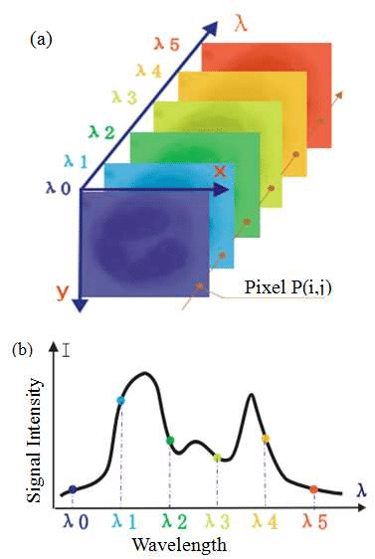
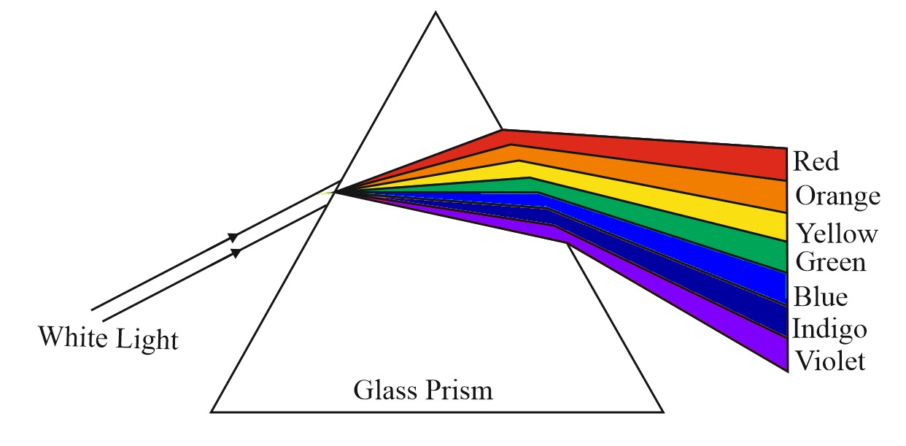
Visible Light and Colors

Slide 6
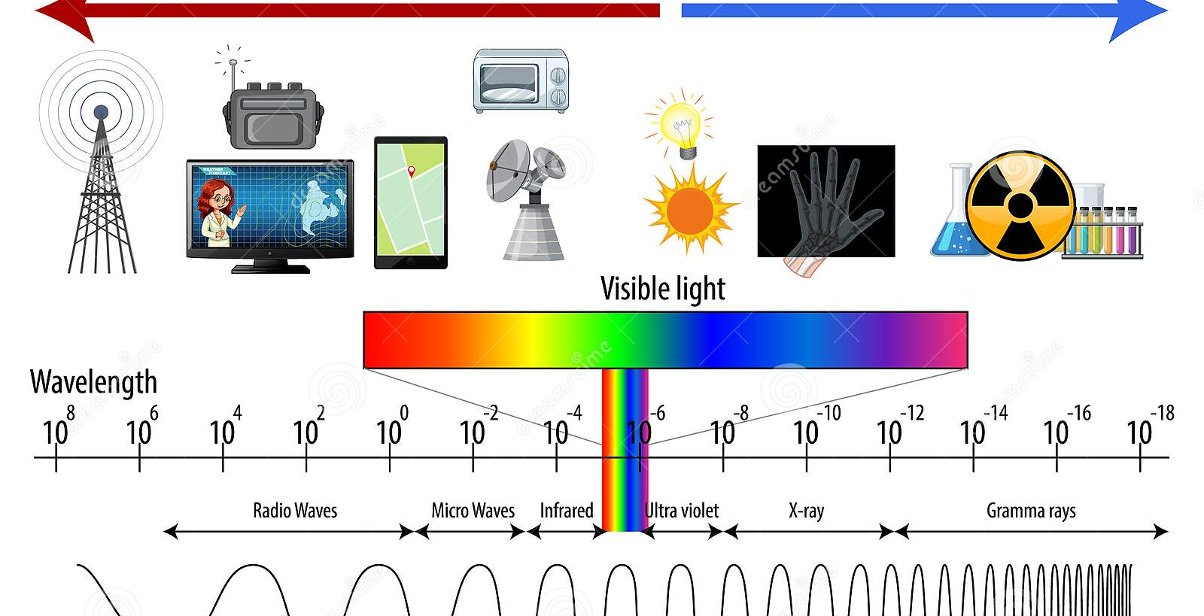
Electromagnetic Spectrum

Slide 7
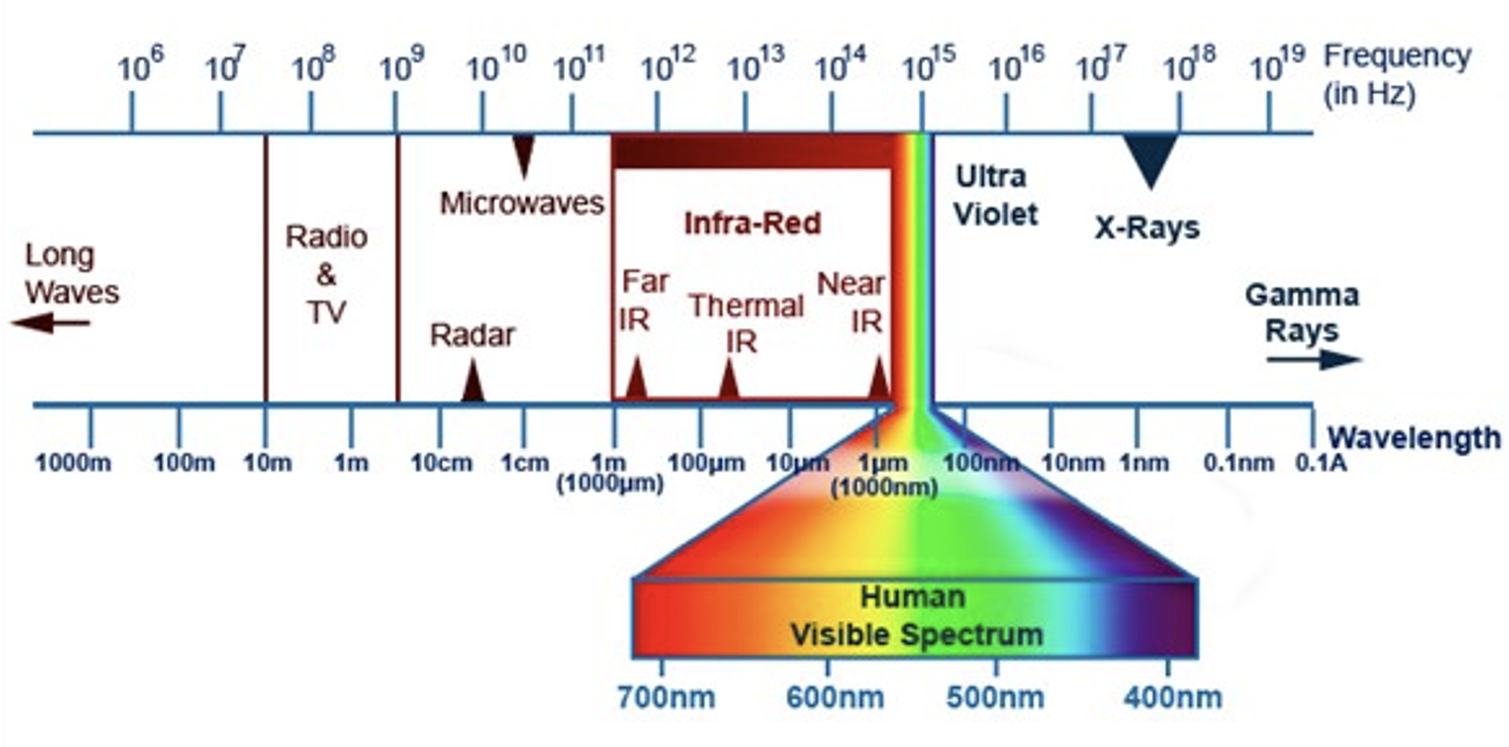
Infrared Band

Slide 8
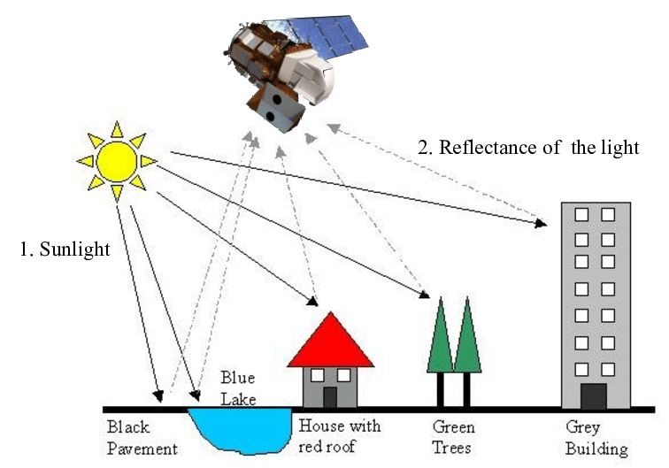
Reflectance of Light

Slide 9
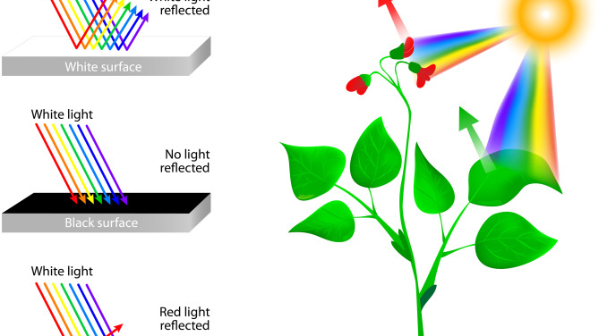
Colors and Reflectance

Slide 10
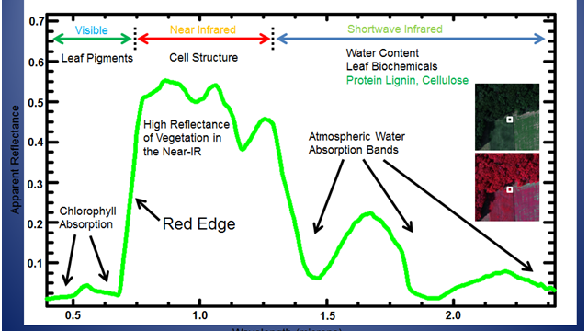

Slide 11
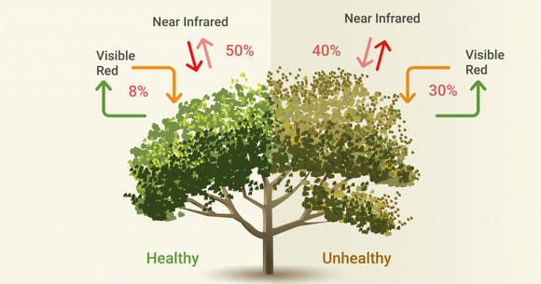

Slide 12
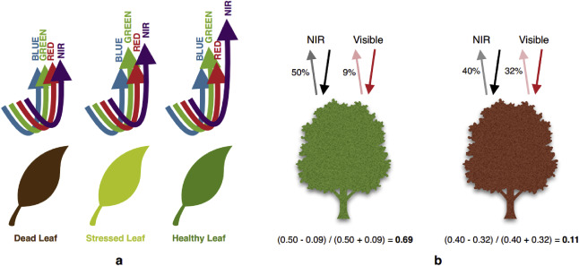

Slide 13
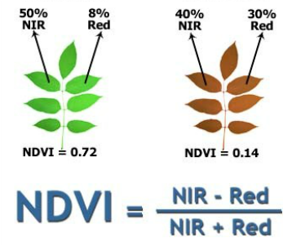

Slide 14
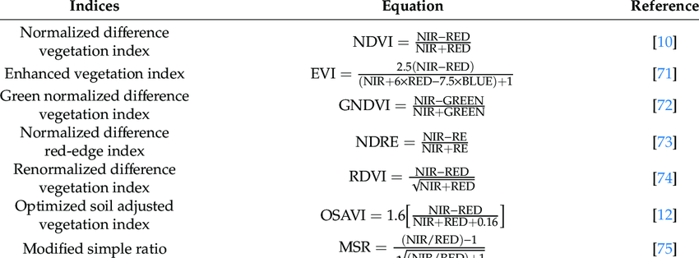

Slide 15
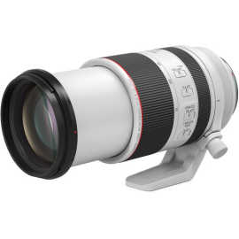
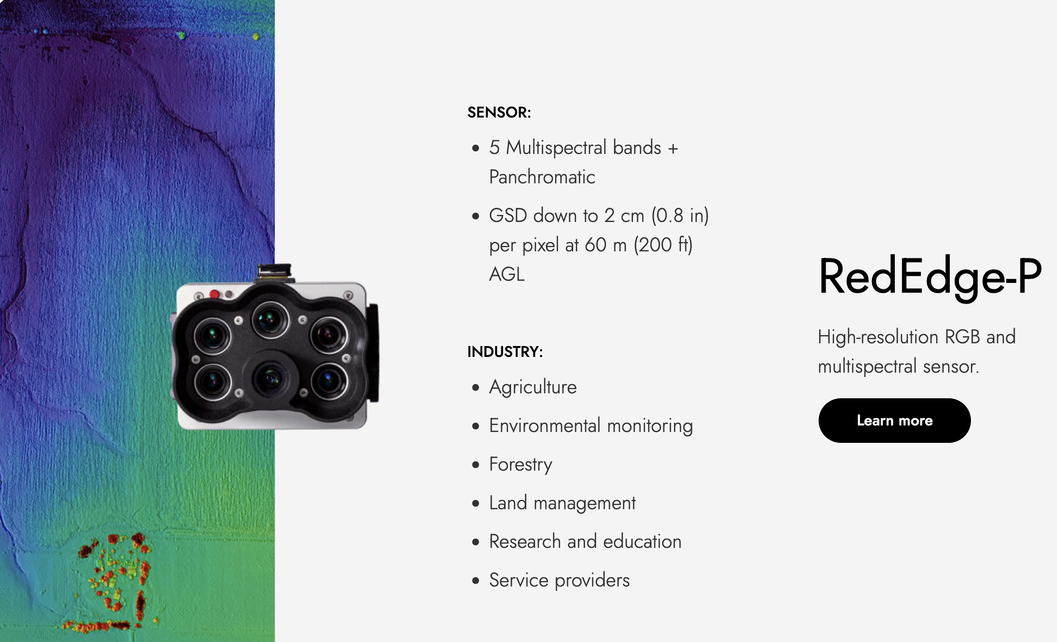
Sensors – Precision Agriculture Lab

Slide 16
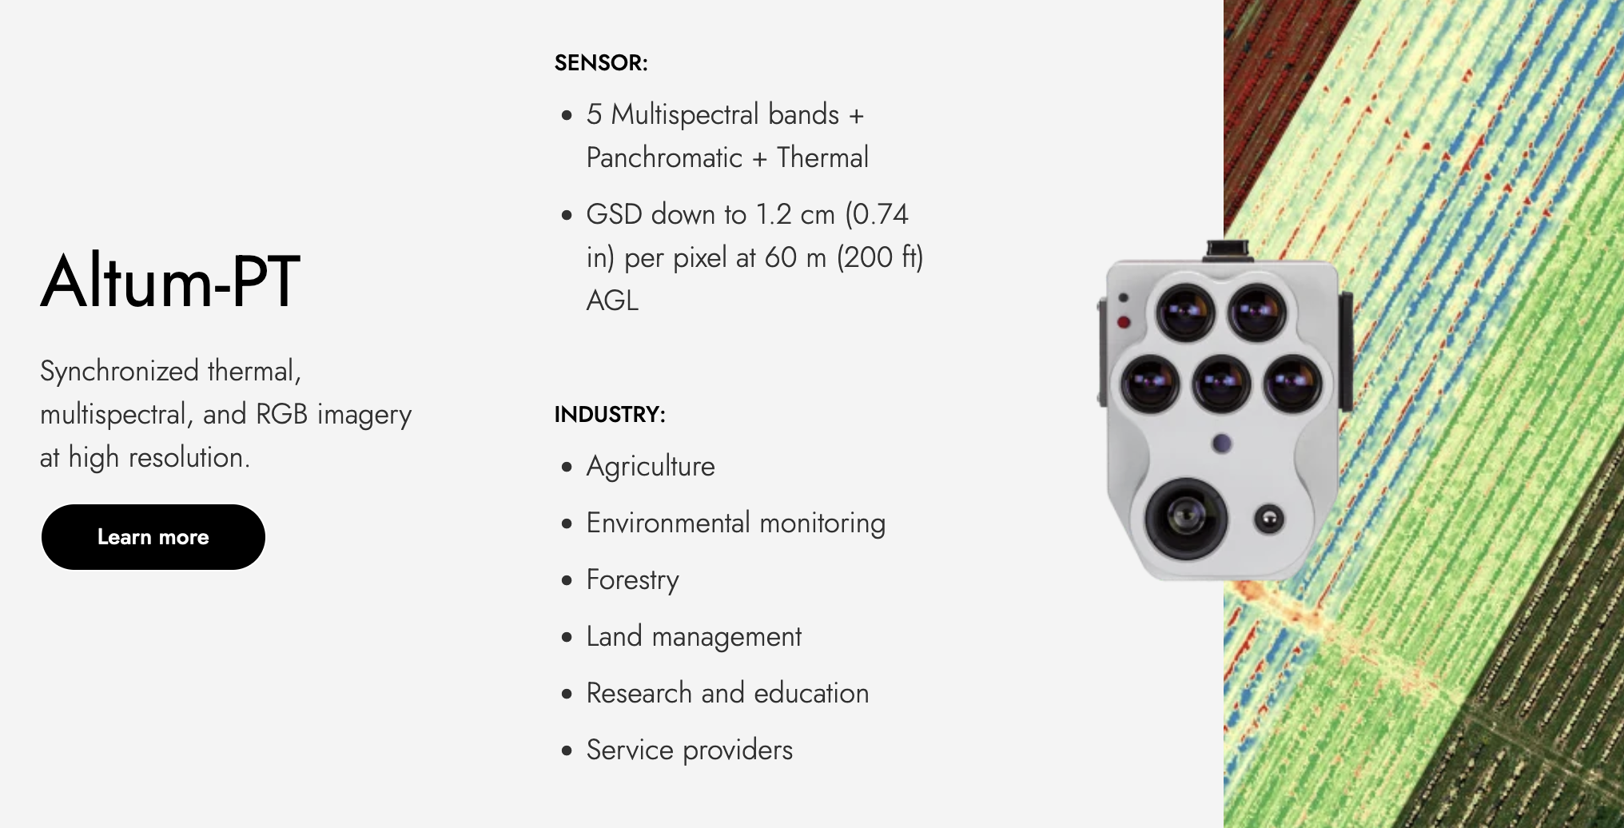
Sensors – Precision Agriculture Lab

Slide 17
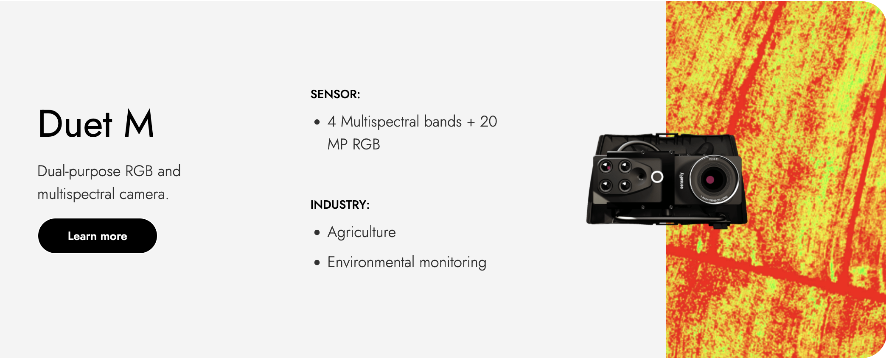
Sensors – Precision Agriculture Lab

Slide 18
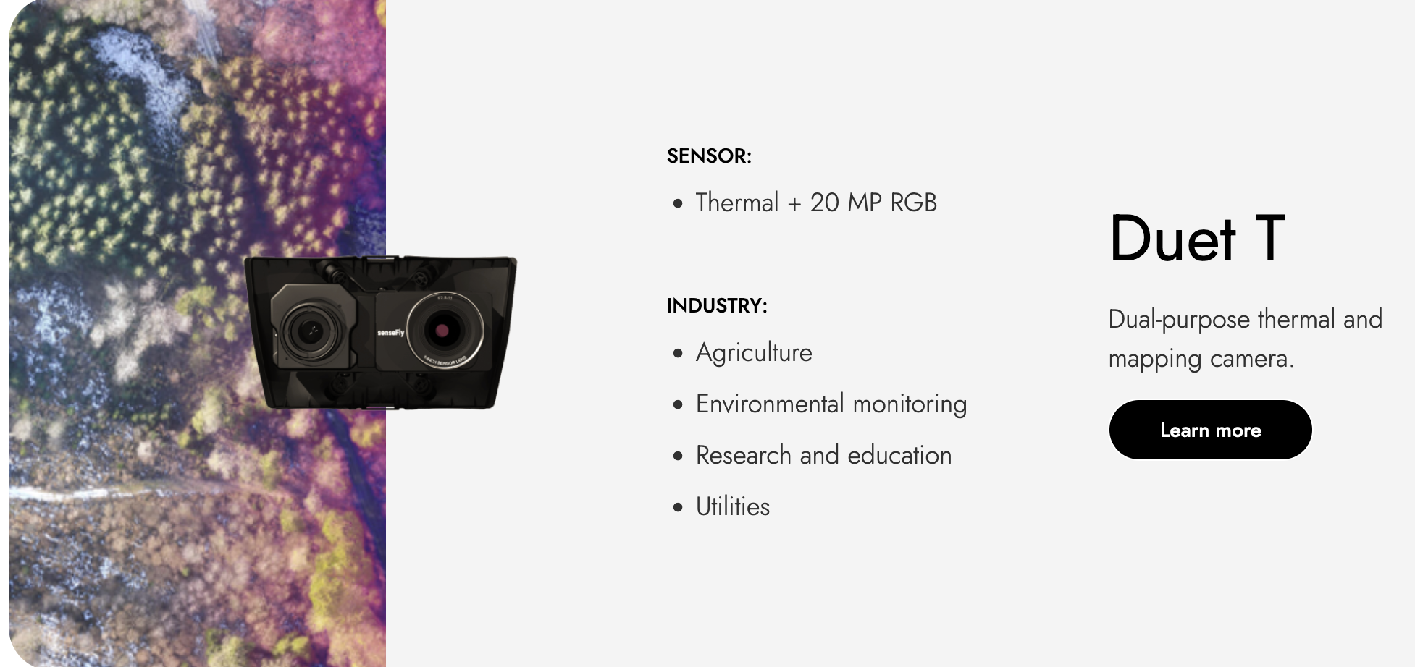
Sensors – Precision Agriculture Lab

Slide 19
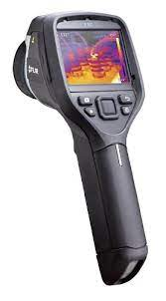
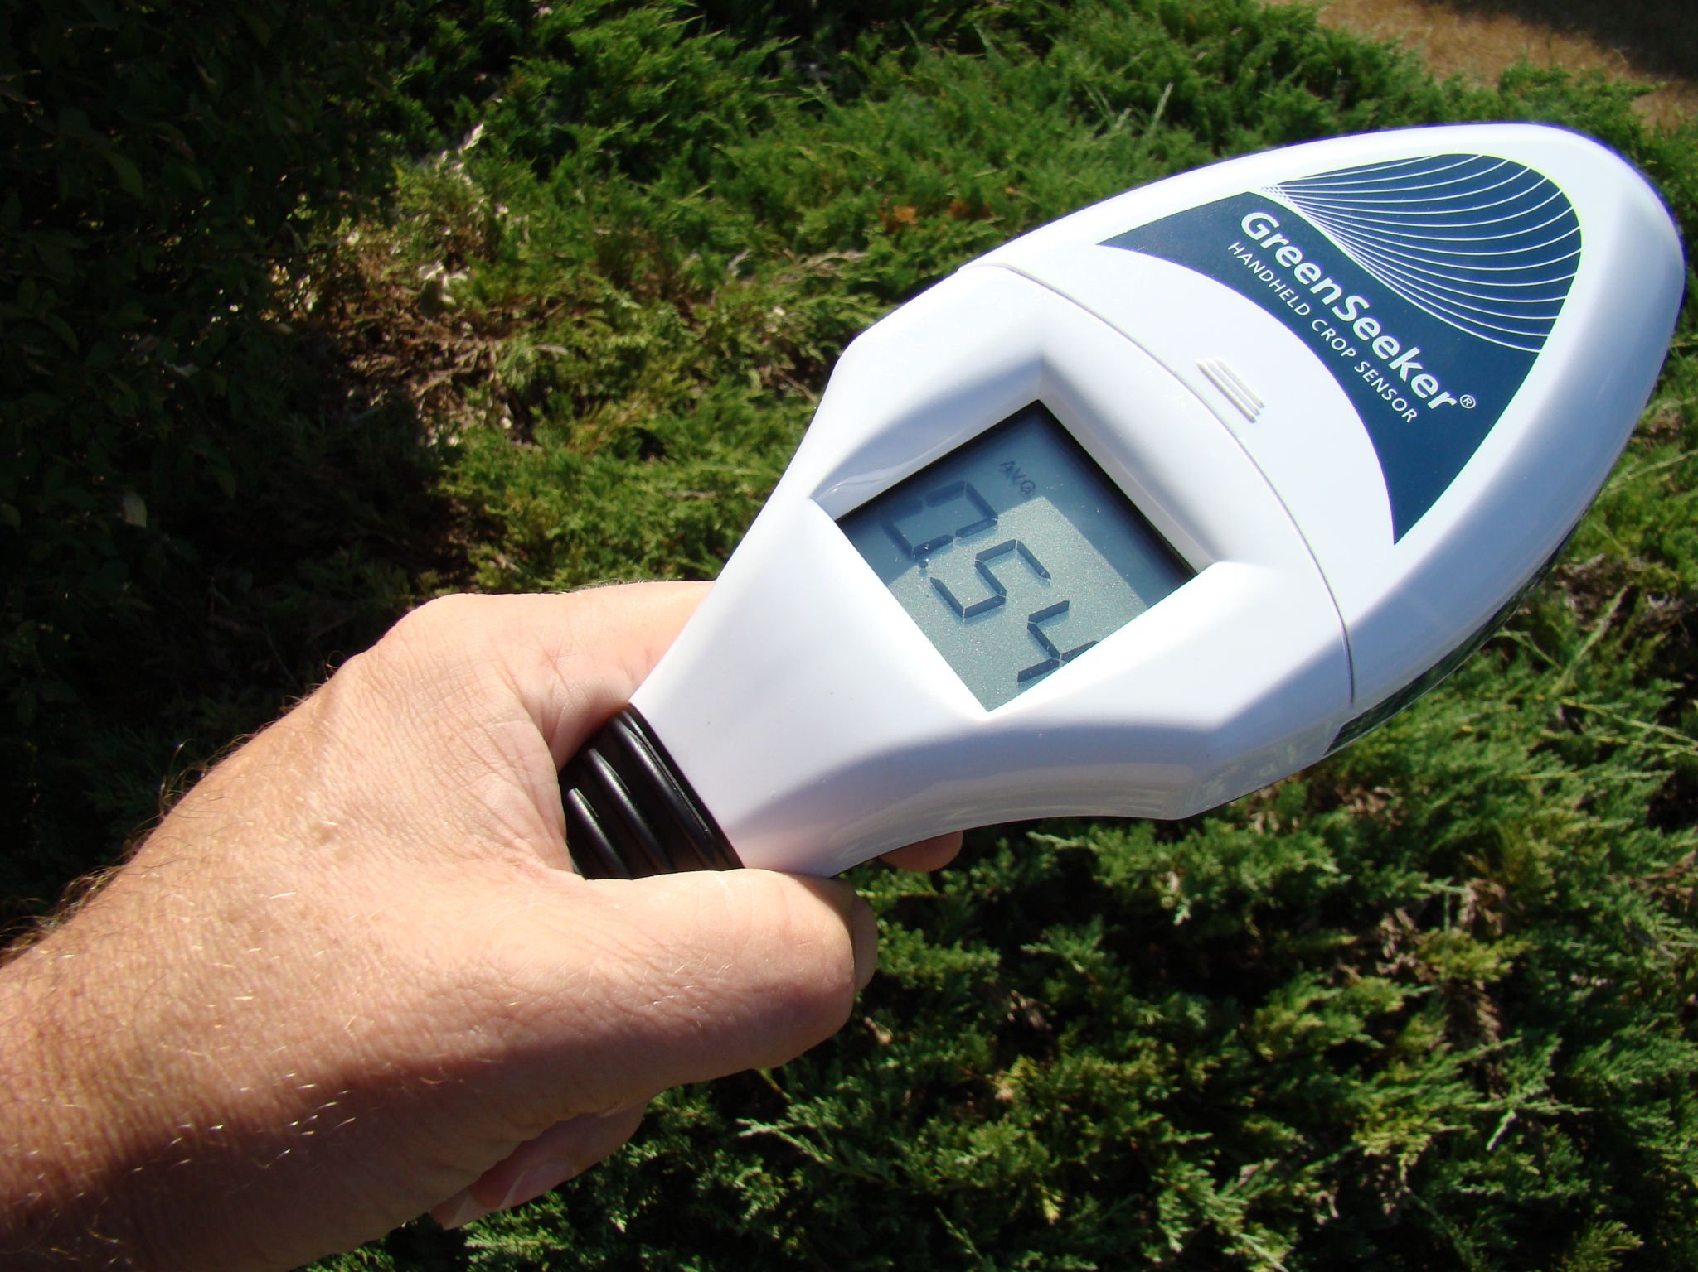
Handheld Sensors – Precision Agriculture Lab
FLIR E6-XT Thermal Imaging Camera
GreenSeeker Handheld Crop Sensor

Slide 20
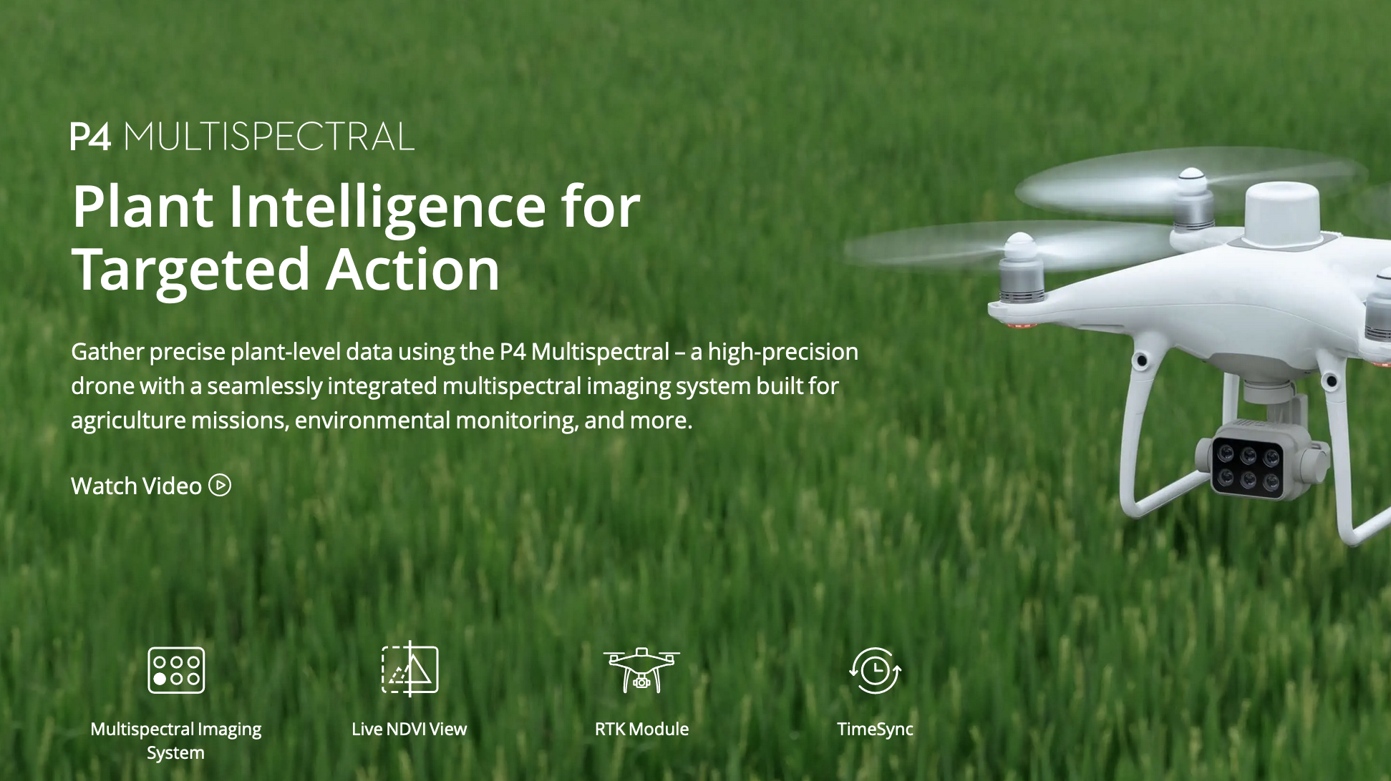
Platforms – Precision Agriculture Lab

Slide 21
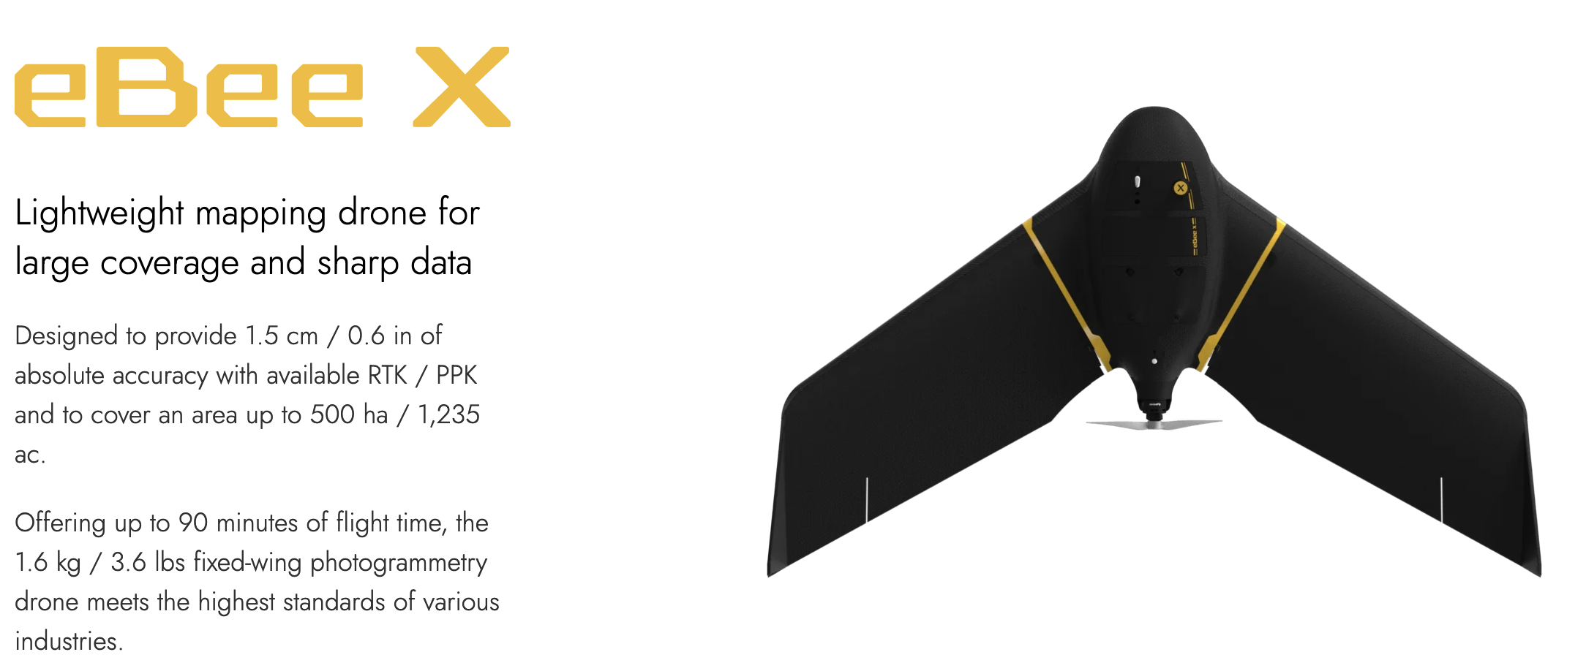
Platforms – Precision Agriculture Lab

Slide 22
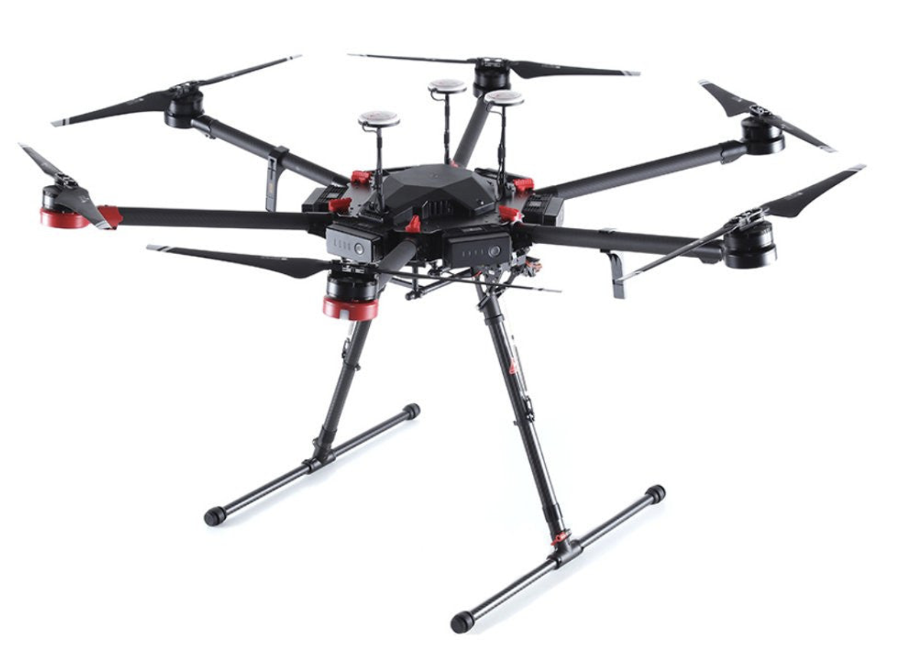
Platforms – Precision Agriculture Lab
DJI Matrice M600 PRO

Slide 23
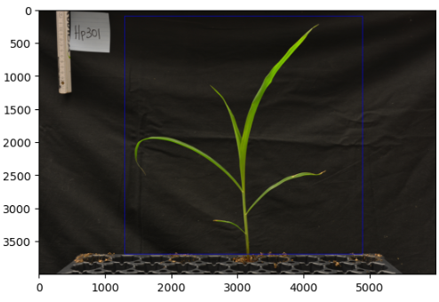
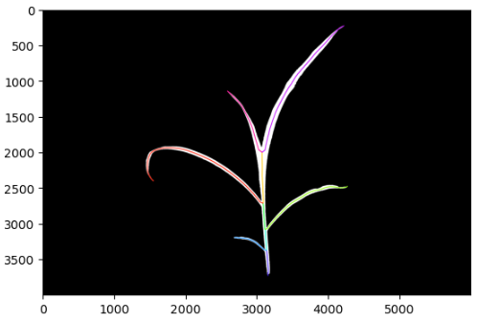
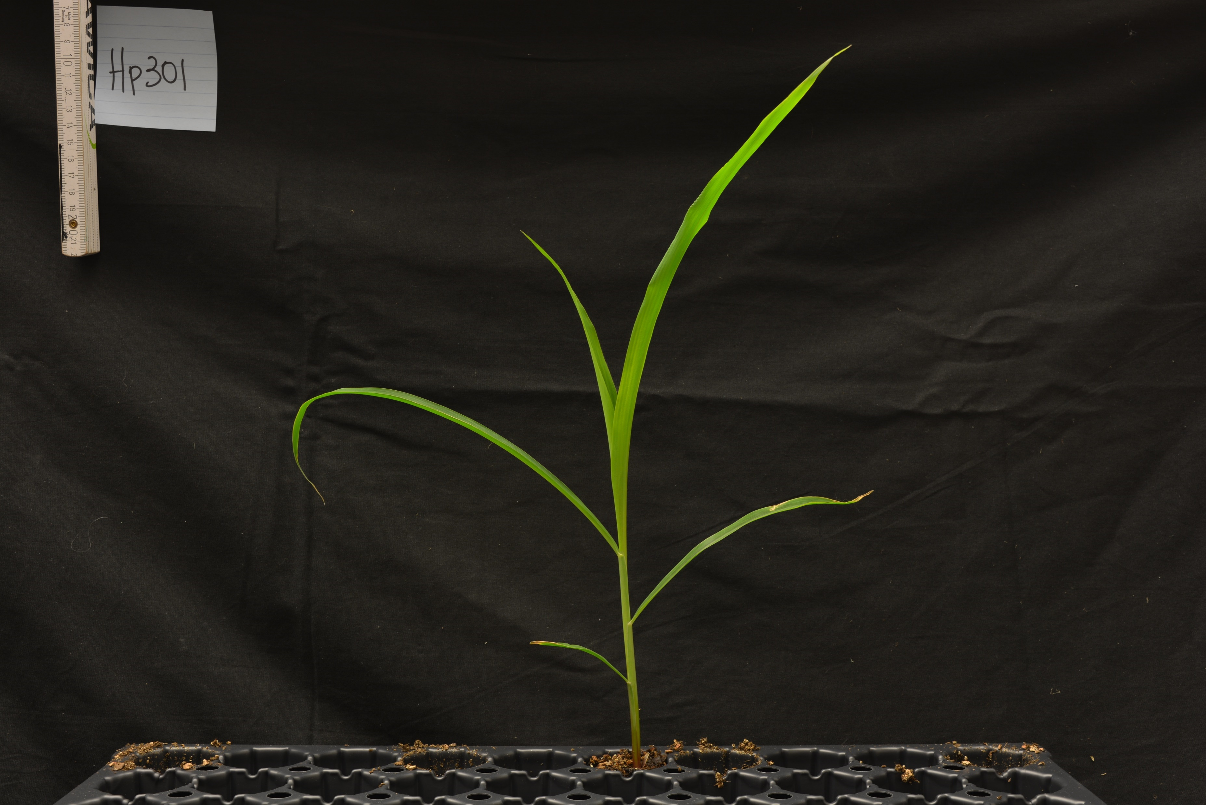
Phenotyping – Plant Level
Maize Image
Region of Interest
Segmentation

Slide 24
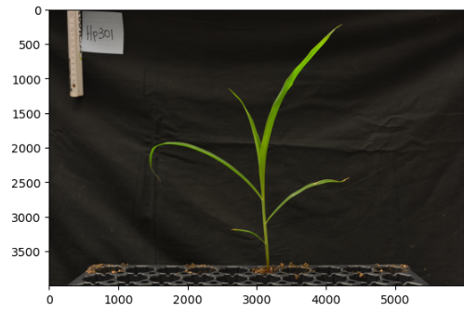
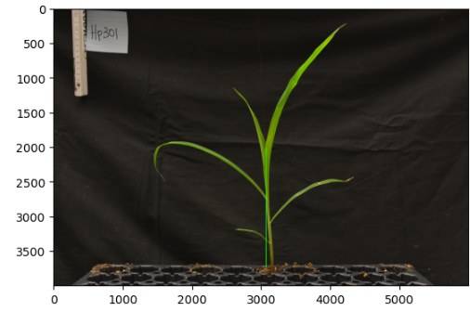
Height Detection
Plant Height Detection
Stem Height Detection

Slide 25
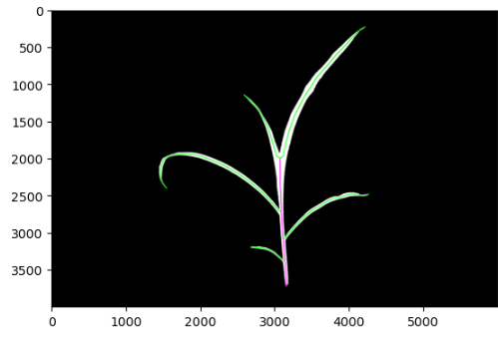
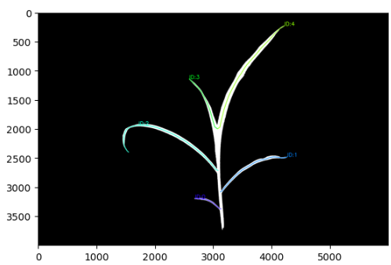
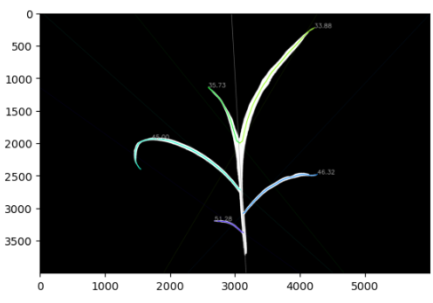
Leaf Segmentation
Leaf Instances
Leaves Count
Leaves Angles

Slide 26
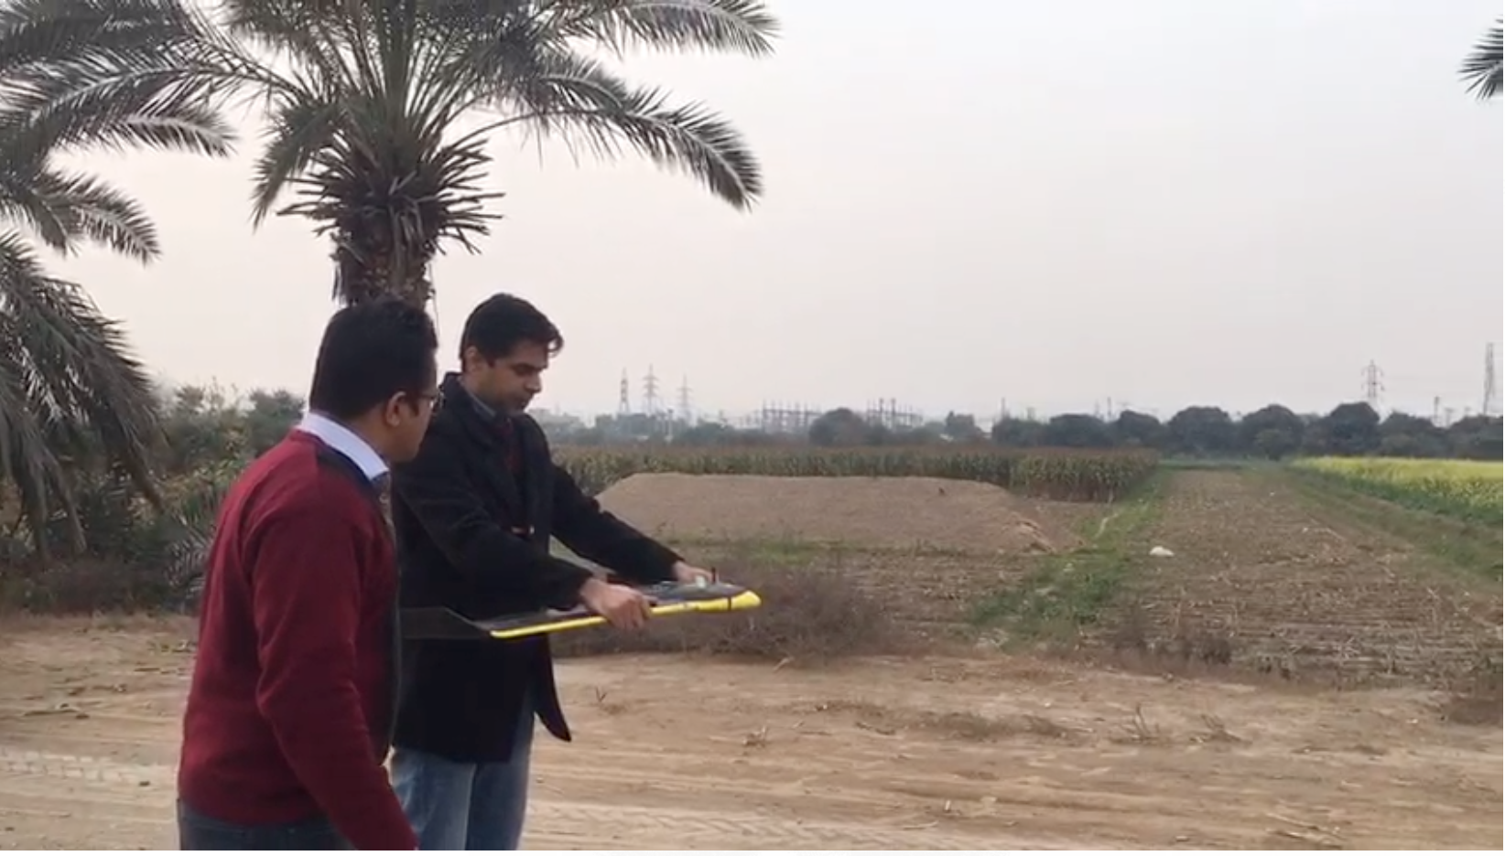
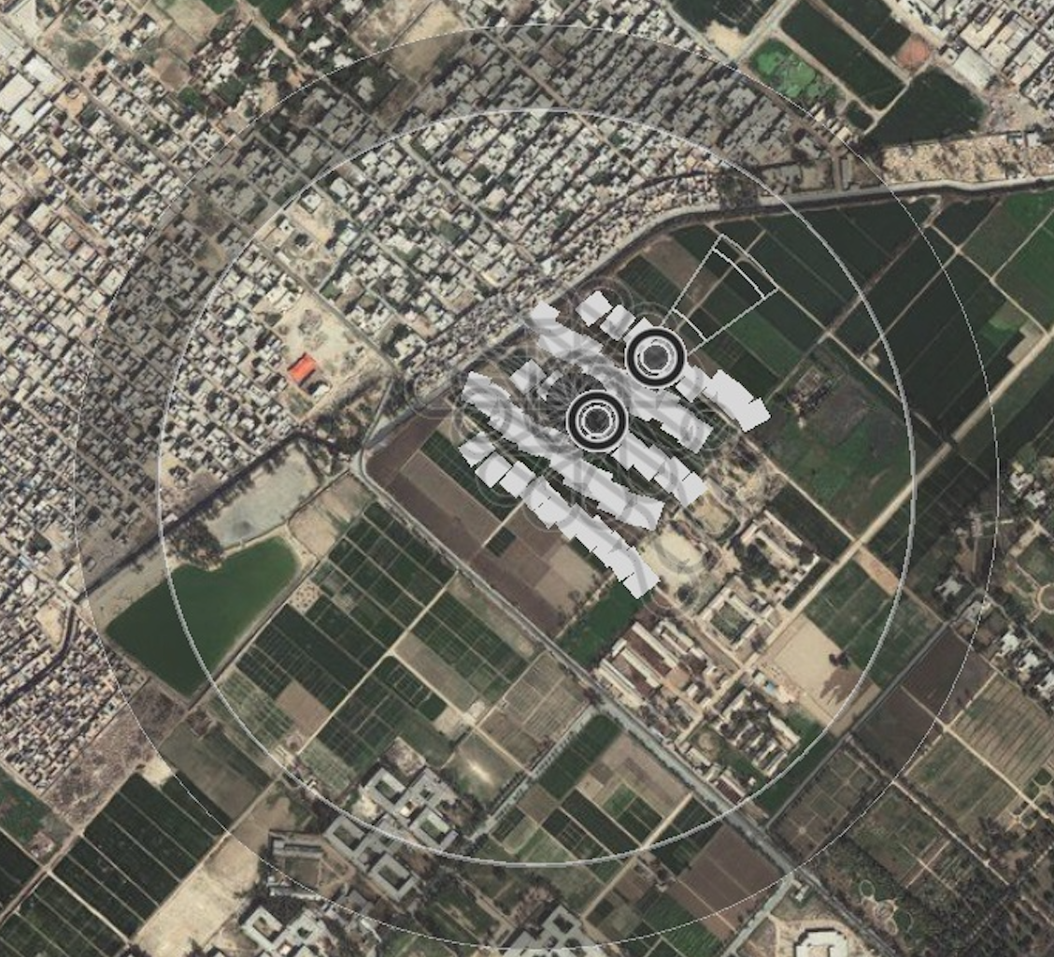
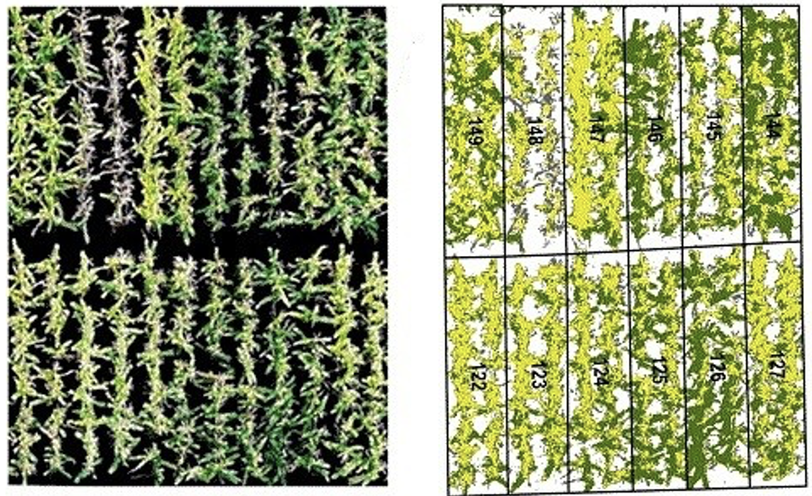
Plant Phenotyping – Plot Level

Slide 27
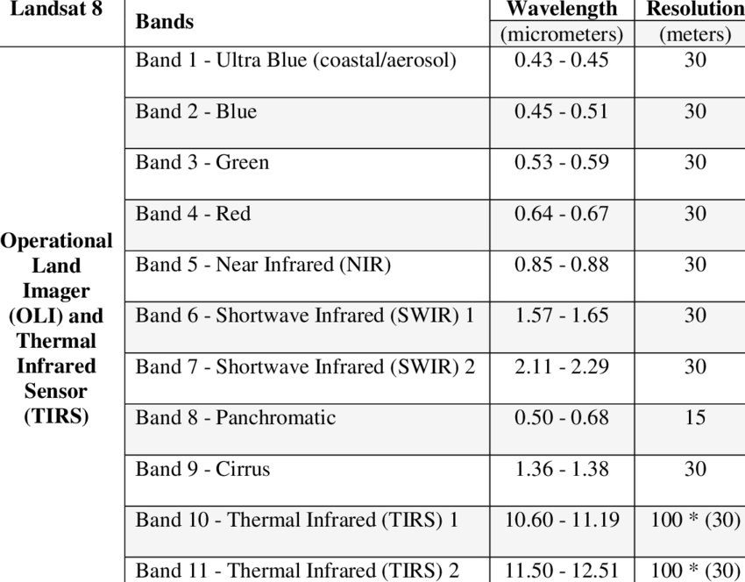

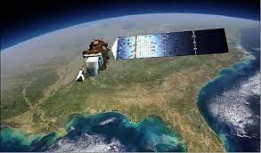
Satellite Image Processing–Regional Level
February 11, 2013

Slide 28

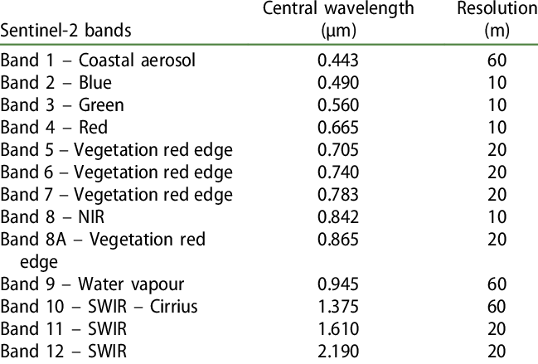
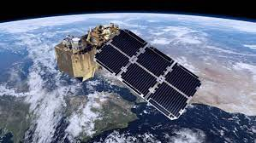
Satellite Image Processing–Regional Level

Slide 29
High-resolution Satellite Imagery
Source | Launch Year | Orbit altitude (km) | Panchromatic (nm) | Spatial resolution (m GSD) * | Multispectral | Spatial resolution (m GSD)* | Other | Spatial resolution (m GSD) | Temporal resolution (days)* | Swath width at Nadir (km)
WorldView-1 | 2007 | 496 | NA | 0.50 | – | – | – | – | 1.7 | 17.6
GeoEye | 2008 | 770 | 450–800 | 0.46 | R, G, B, NIR | 1.84 | – | – | 2.1 | 15.2
WorldView-2 | 2009 | 770 | NA | 0.46 | R, G, B, Y, RE, NIR1, NIR2, Coastal | 1.84 | – | – | 1.1 | 16.4
Pleiades-1A | 2011 | 695 | 480–830 | 0.50 | R, G, B, NIR | 2.00 | – | – | 1.0 | 20.0
Pleiades-1B | 2012 | 695 | 480–830 | 0.50 | R, G, B, NIR | 2.00 | – | – | 1.0 | 20.0
KOMPSAT-3¹ | 2012 | 685 | 450–900 | 0.70 | R, G, B, NIR | 2.8 | – | – | 1.4 | 15.0
WorldView-3 | 2014 | 617 | 450–800 | 0.31 | R, G, B, Y, RE, NIR1, NIR2, Coastal [400–1040 nm] + 8 SWIR bands [1195–2365 bands] | 1.24 OR 3.70 | 12 CAVIS Bands [405–2245 nm] | 30.0 | 1.0 | 13.0
KOMPSAT-3A | 2015 | 528 | 450–900 | 0.55 | R, G, B, NIR | 2.20 | MWIR [3.3–5.2 µm] | 5.5 | 1.4 | 12.0
SkySat^{2, 3} | 2013–2017 | 475–575 | 450–900 | 0.72–0.86 | R, G, B, NIR | 1.00 | – | – | 4.0–5.0 | 6.6–8.0

Slide 30
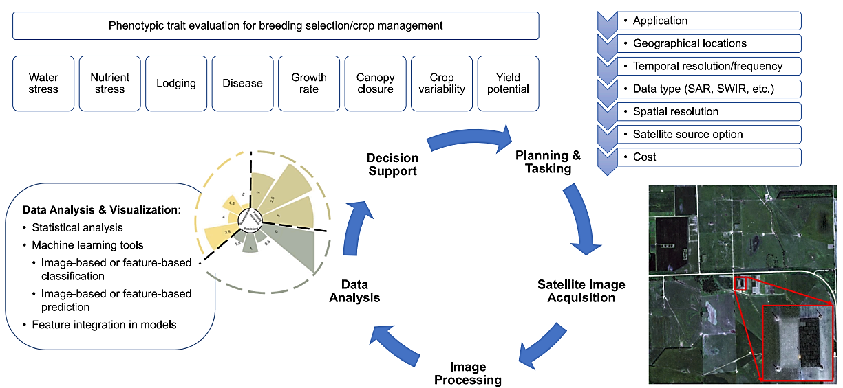
Work Flow

Slide 31
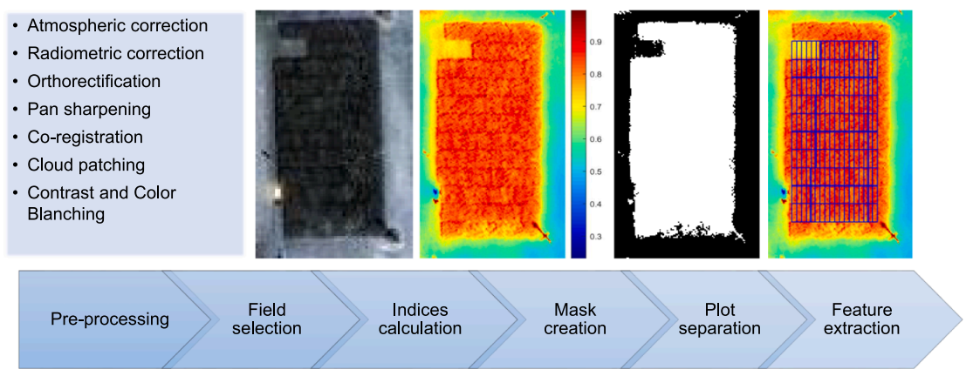
Practical Implementation

Slide 32
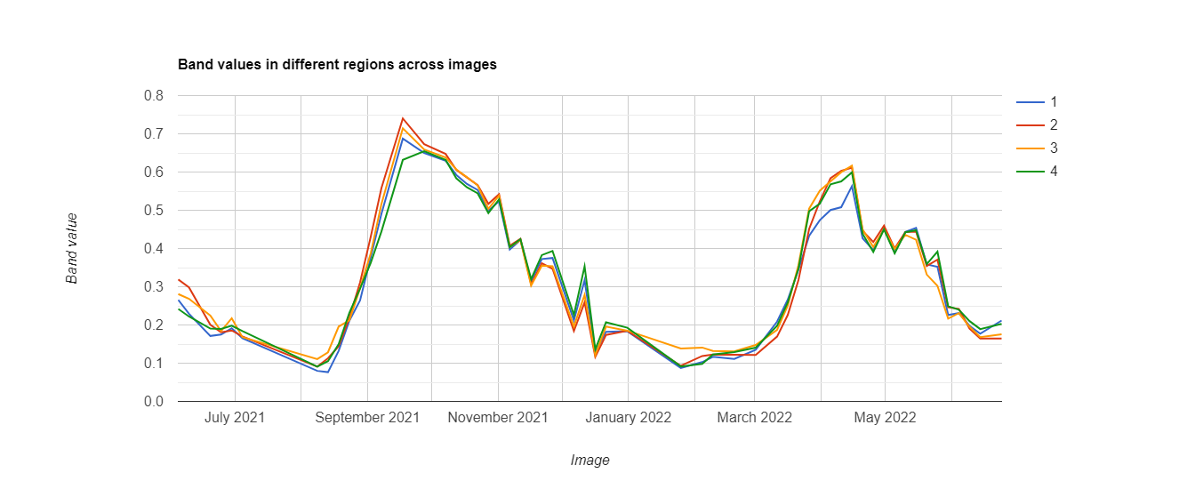
Time Series NDVI values of Maize

Slide 33
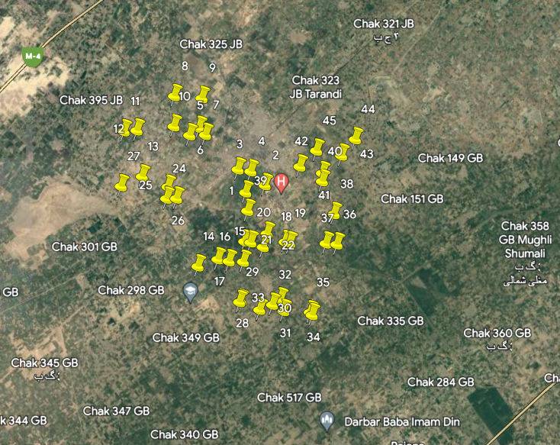
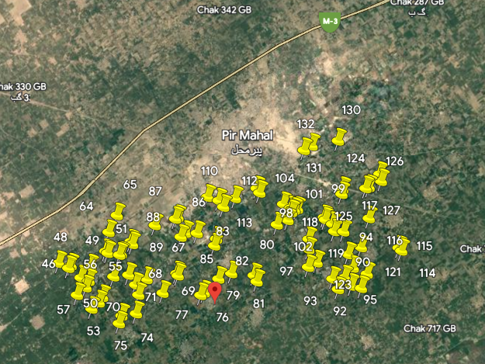
Maize Crop Area Estimation with Farmdar

Slide 34


